Slide 1

Cyclistic Bike-share Case Study
Raphael Florea

Slide 2
CONTENTS
Business Task………. ……………………………………………………………………………………3
Data Collection……. ……………………………………………………………………………………4
Data Preparation.…. .……………………………………………………………………………………5
Analysis……………. .……………………………………………………………………………………7
Visualisations. ……………………………………………………………………………………………10
Recommendations.………………………………………………………………………………………12

Slide 3
Business Task
INTRODUCTION TO CYCLISTIC
Cyclistic is a bike-sharing program in Chicago, and offers a range of bikes including standard bikes and cargo bikes, but also aims to be more inclusive by having bikes designed for those with disabilities
The program consists of almost 700 bike-sharing stations in Chicago and approximately 5800 bikes overall
BUSINESS OBJECTIVE
Cyclistic’s finance analysts have discovered that annual members to the bike-sharing program are far more profitable than casual riders
The main objective is to focus on targeting existing casual riders so they can be converted into annual members, rather than trying to find more casual riders
Likewise, the marketing team wants to understand the differences between current annual members and casual riders, so they can better target the program to current casuals and convert them

Slide 4
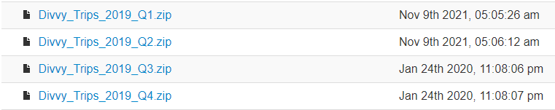
DATA COLLECTION
DATA SOURCE
The data is all in csv format, and can be obtained from the following source:
Index of bucket "divvy-tripdata“
The data is assumed to be accurate and useful as it is Cyclistic’s own historic trip data that they have already collected
DATA USED
The 4 datasets obtained were from each quarter of 2019, as this was the data for the most recent year that quarterly data was still being collected

Slide 5




DATA PREPARATION (TOOLS USED)
EXCEL
Excel, and its Power tools, were used to complete the analysis, due to Excel’s versatility and Power Query’s ability to handle millions of rows of data
Power Query was used to assist in organising the data, by appending the quarterly datasets together
Excel also proved to be highly effective as Pivot Tables could be built off of the new dataset, which would then
Finally, Pivot Charts were used to provide further visual insight into the data

Slide 6
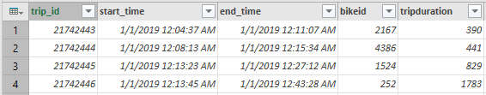
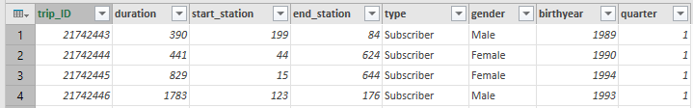
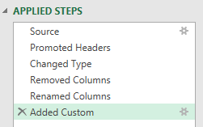

DATA PREPARATION (MERGING THE DATA)
POWER-QUERY PROCESS
The 2019 bike-sharing data came separately in 4 quarters, so it all needed to be merged together
First, for each quarter, the columns in the table needed to be renamed to be consistent with the other tables
Unnecessary columns were removed
An additional column named ‘quarter’ was added to identify the quarter for a particular row of data
Finally, all the last 3 quarters tables were appended to the quarter 1 table to make a dataset for the entire year of 2019
Queries for final dataset:

Slide 7
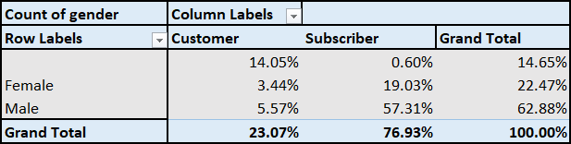
ANALYSIS (Breakdown of gender)
ANALYSIS TOOLS
A pivot table and chart was made to see the differences in casual customers and annual subscribers regarding their gender
RESULTS
Subscribers were found to be predominantly male, though the majority of casual customers did not state their gender
Casual riders may feel uncomfortable specifying their gender, so this should be taken into account for future marketing campaigns, especially considering that the program aims to be inclusive

Slide 8
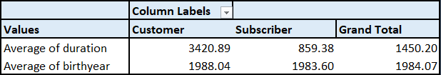
ANALYSIS (Breakdown of AVERAGES)
ANALYSIS TOOLS
Again, pivot tables and related pivot charts were used
RESULTS
Average trip duration was found to be a lot longer for casual riders than annual subscribers, being around 4 times longer
Average birth year suggested that casuals are around 5 years younger, but this is a less significant difference
Average trip duration for each customer type (in seconds)

Slide 9
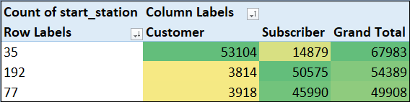
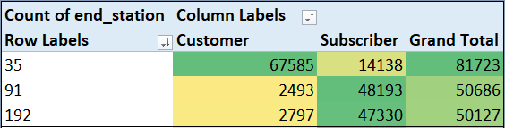
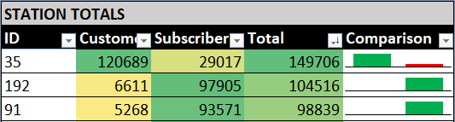
ANALYSIS (MOST POPULAR STATIONS)
ANALYSIS TOOLS
2 pivot tables were made, one for the starting station usage amount and another for ending station usage
A 3rd table was created using Excel’s INDEX and MATCH functions, which found the combined usage for each station, and also featured Sparklines
RESULTS
It is found that some stations, such as station 35, have an extremely high casual rider count compared to subscribers, and these could be stations worth focusing on

Slide 10
VISUALISATIONS (RIDERS PER QUARTER)

Slide 11
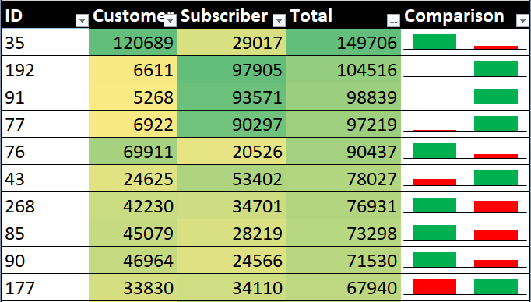
VISUALISATIONS (TOP 10 MOST USED STATIONS)

Slide 12
RECOMMENDATIONS
TRIP DURATION RECOMMENDATION
It has been found that casual riders on average ride for 4 times longer per trip than annual members
This may mean that while the program is able to market well to riders who want to make short frequent trips, it is unable to capture the long-term attention of riders who go on longer journeys
Thus, the marketing team should focus on what kinds of riders prefer longer journey times, and market the bikes such that they are suitable for those kinds of riders as well
STATION RECOMMENDATION
Some stations, such as station 192, 91, and 77 have a very high ratio of subscribing customers to casual riders, indicating the program at these particular stations are highly effective at converting casuals to annual members
Other stations seen in the visualisations, in particular 35, and 76, are unable to convert casuals into members effectively, meaning the marketing campaign in these areas is possibly lacking and needs to be improved
Thus, the marketing team should not alter stations that are already effectively converting casuals to members, instead devote its resources to stations that are underperforming in this regard

